Slide 1
The importance of Automating routine tasks
Andy Mallon

Slide 2
Andy Mallon
Product Manager at SentryOne
Working with SQL Server since 2003
Background in Tech Support, Database Administration, and Database Architecture
Lazy
Impatient

Slide 3



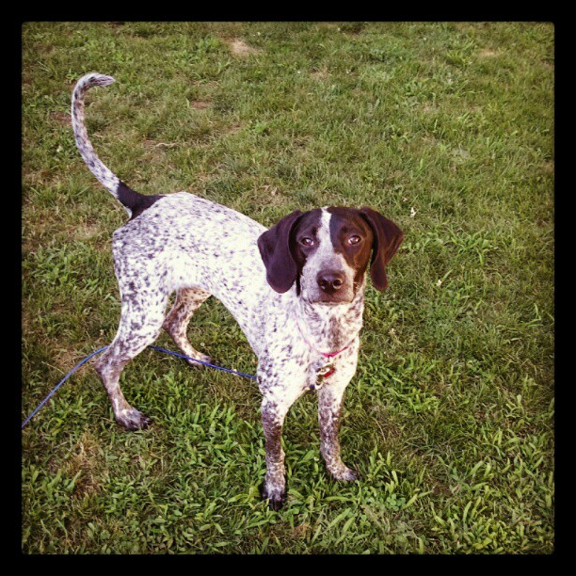



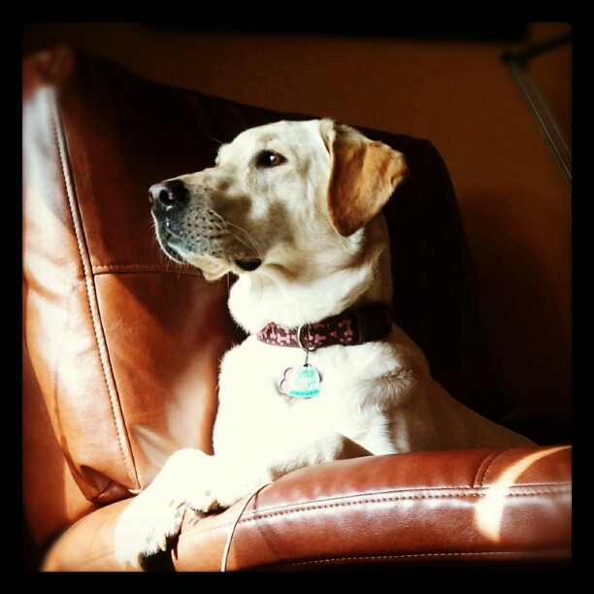
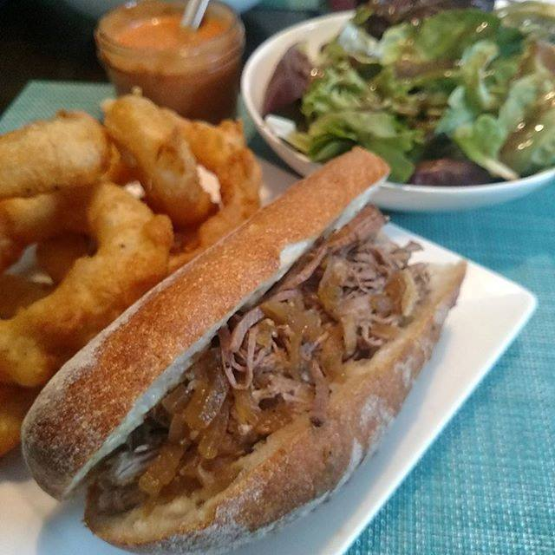



Notes:
Some of the things I love most in life– My husband, my pups, my food (I love to cook), and my city.

Slide 4


Contact Andy
Andy@AMtwo.co
@AMtwo
am2.co
andy@am2.co

Slide 5
Slides + Materials
Github.com/amtwo/presentations
@AMtwo
am2.co
andy@am2.co

Slide 6

Session Feedback
Tell me what you don’t like
Tell me what can be better
Tell me what you like

Slide 7
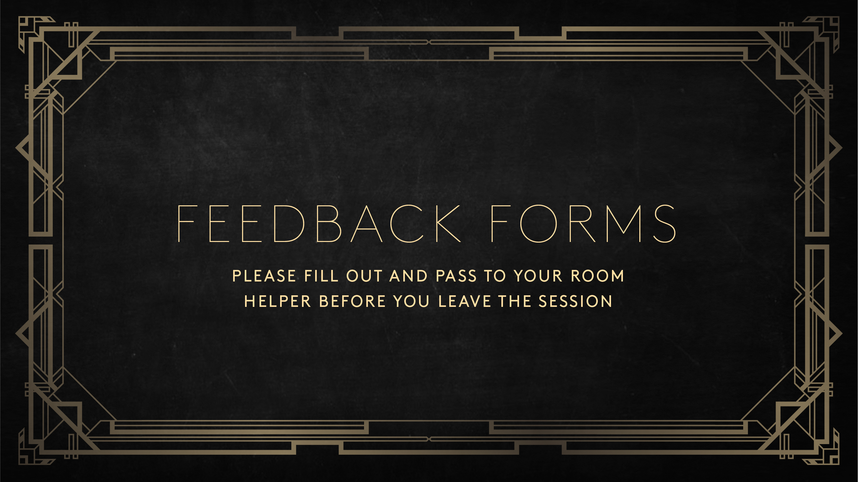

Slide 8

I'm also gonna need you to go ahead and silence your cell phones
Yea…….You apparently didn’t put one of the new coversheets on your TPS reports.

Slide 9
What we’ll cover
Why automation is important
Identify tasks you should automate
Picking the right tool for the job
We won’t be writing any code

Slide 10
Before I start…
Who uses checklists?
Who has scripted those checklists?
Who is lazy?
Who is impatient?

Slide 11
Why is automation important?

Slide 12
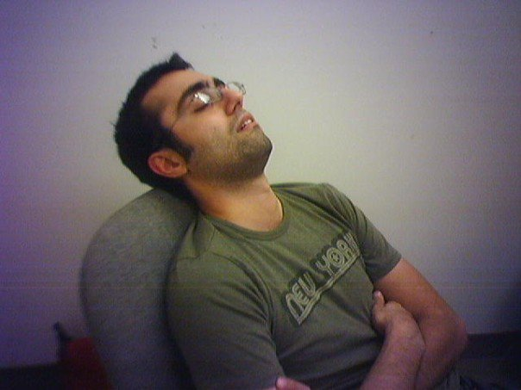
I’m lazy
Boring tasks are boring
Repetitive tasks are boring
I want to work smarter, not harder

Slide 13
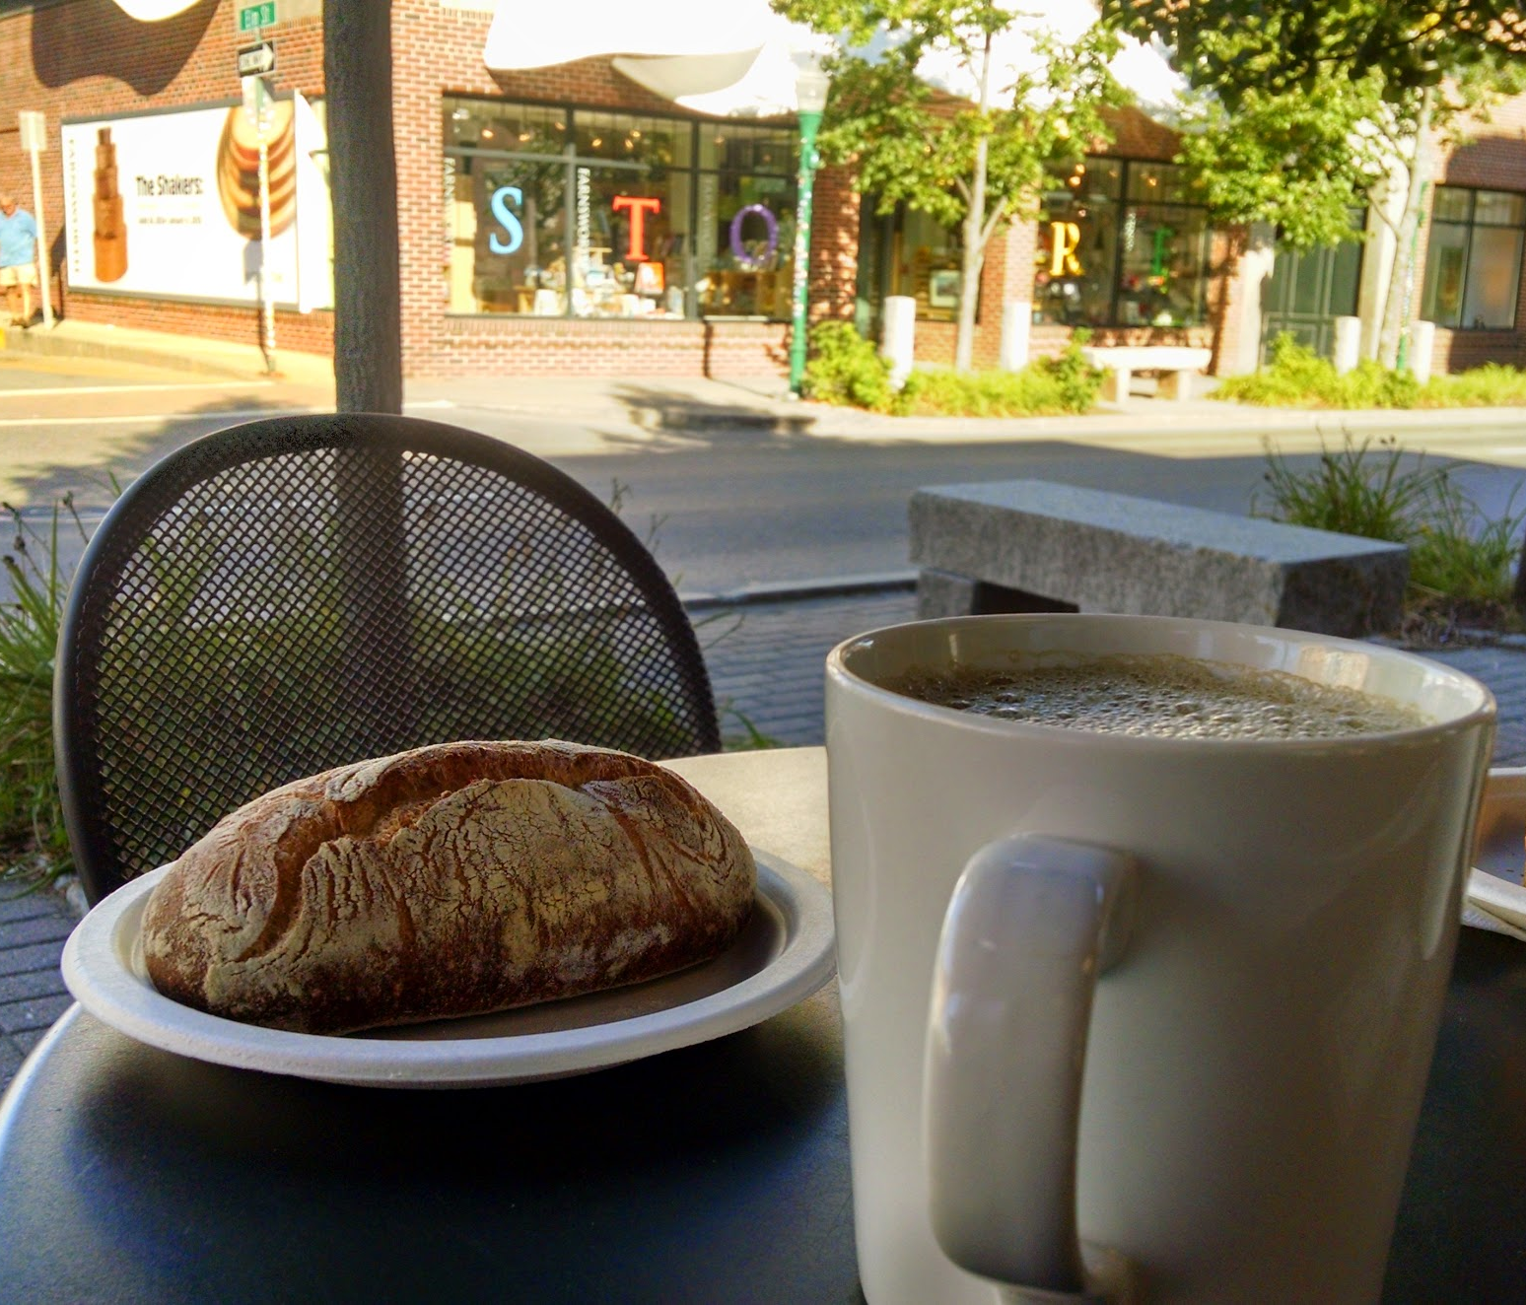
I’m busy
I have a lot of work to do for work
I like to relax on nights & weekends
I want to be bored

Slide 14
Busy is a four-letter word
Jes Borland – Session recording
https://am2.co/busy-is-a-four-letter-word
I want to be bored!

Slide 15

Learn to say “no”
You can’t do everything
You can do more if you automate things
But you can’t automate everything
So you can’t do everything
Be nice about it
Use “No” to start the conversation

Slide 16
Checklists & Automation

Slide 17
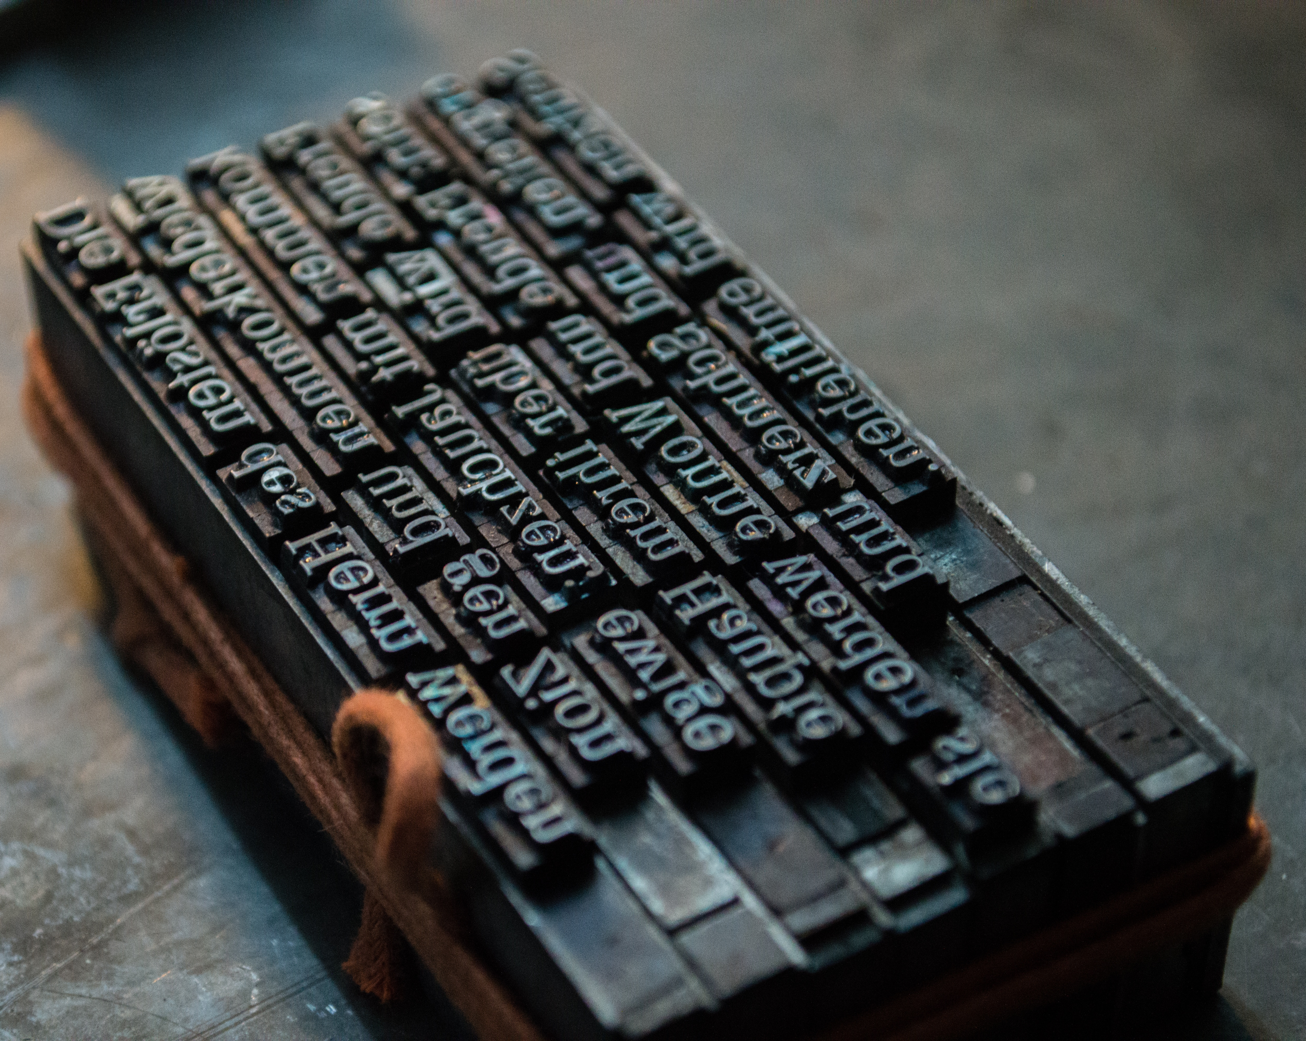
Consistency
Easier to troubleshoot problems
Easier to predict behavior

Slide 18
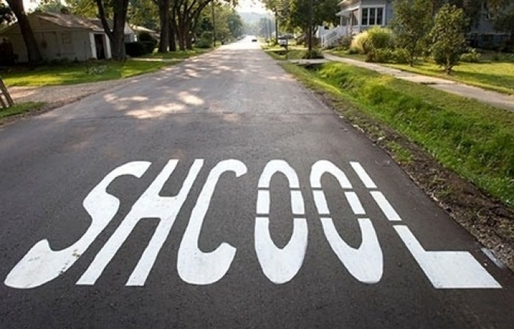
Consistency
Get things right every time
Get things wrong every time

Slide 19

Consistency…. Standard vs Exception

Slide 20
Consistency????

Slide 21
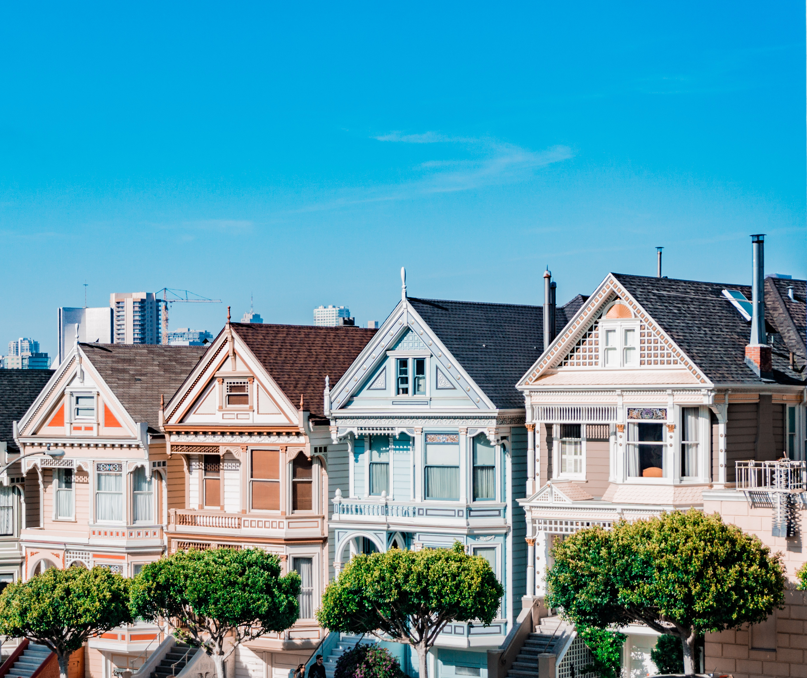
Standard build/config/process
The default
Everyone uses it unless they can’t
Basis for SLAs
You can have multiple “standards”

Slide 22

Exception build/config/process
Supported alternative
Known pitfalls
Maybe lessened SLAs

Slide 23
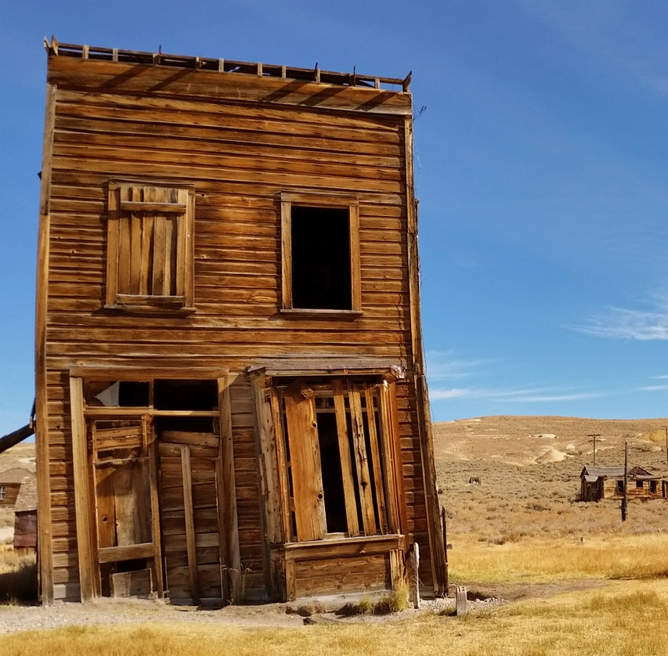
Prohibited build/config/process
Scenarios that aren’t allowed in your environment
Security
Industry regulation
Lack of knowledge
Lack of money

Slide 24
Why automation?
Notes:
How to convince yourself or convince your boss.

Slide 25
Productivity
Do more faster
Less time on routine tasks
More time on unique tasks

Slide 26
Save time & money
Save on labor costs
Mitigate labor shortages
Increase your value to your employer

Slide 27
Improve quality
Humans make mistakes
Automation makes the same mistake repeatedly
Fixing automation fixes the error forever*
* For the specific case you coded a fix for. A different flavor of the problem might come back. Your fix is only as good as your code.

Slide 28
Improve transparency
Generate detailed logging
Make logs discoverable
Easier to research problems

Slide 29
Improve speed
Product releases are getting faster
Move faster without having to run
Faster results make happy customers

Slide 30
Standardization
Easier to identify problems
Easier to predict problems
Easier to prevent problems

Slide 31
What do I automate?

Slide 32
Don’t automate everything
Not everything can be automated
Not everything should be automated
Who is familiar with xkcd?

Slide 33
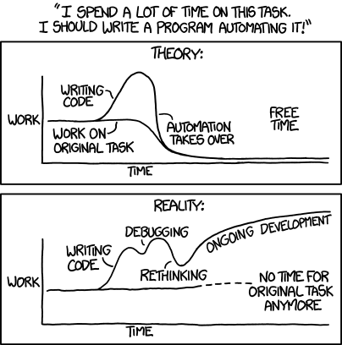
xkcd.com/1319 : Automation

Slide 34
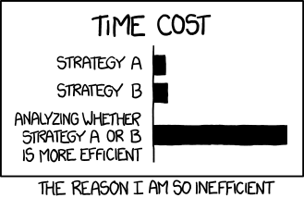
Xkcd.com/1445 : Efficiency

Slide 35
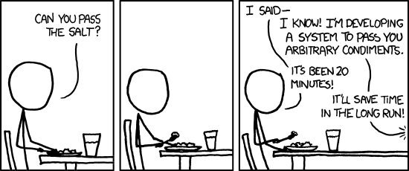
xkcd.com/974 : The general problem

Slide 36
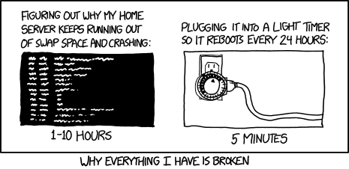
xkcd.com/1495 : Hard reboot

Slide 37
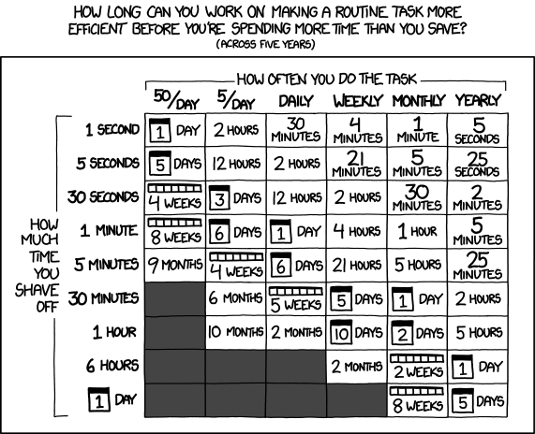
xkcd.com/1205 : Is it worth the time?

Slide 38
Fill in the blank
I have a ____________
and every once in a while it __________,
so I just ____________
because fixing this __________ is too hard.

Slide 39
Picking the right tools

Slide 40
Just a few tools in your toolbox
T-SQL
PowerShell
Bash
SSIS
Python
.NET
Selenium
Jenkins
Puppet
Chef
Lambda functions
Azure Automation

Slide 41
Are you doing [task] already?
Develop a process
Develop a checklist
Start scripting individual steps
Save your scripts, stitch them together

Slide 42
Questions?

